Slide 1
FAFSA Information
Mr. Gordon
jgordon@bisdtx.org

Slide 2
Upcoming Events
We have a lot of upcoming events. Please mark these on your calendar.
hi

Slide 3
What is the FAFSA?
FAFSA stands for Free Application for Federal Student Aid
www.studentaid.gov
The FAFSA application is what the government uses to award grants (money you do not have to pay back) and loans (money you do have to pay back)
It will also be used by the state of Texas and your future university to determine grants and loans. For this reason, you should always complete it even if you do not think you will qualify. You can send your information to up to 20 schools.
hi

Slide 4
FAFSA Facts
www.studentaid.gov is where you will create your account and obtain your FSA ID.
FAFSA asks for information from both the student and parents, so both of you will need to create a FSA ID.
Parents will be included on the form until the student is 24.
Due to scammers, please make sure you are accessing the right websites.
The form will be released on December 1, 2024.
hi

Slide 5
FAFSA Facts
You must complete a new application every year that you are in university, but many parts will autofill from the previous year.
The FAFSA will not say how much you are being awarded,
this information will come from your university.
You can make changes if needed.
Some universities may ask you to provide additional documentation, this is called “verification”.
hi

Slide 6
FAFSA Facts
What do I need to complete the FAFSA?
You and your parents’ Social Security Number (SSN)
IRS information or login information for you and your parents
2023 Tax returns
Records of child support received
Current balances of cash, savings, and checking accounts
Net worth of investments, business, and farms
Individual email addresses
Date parents were married
hi

Slide 7
FAFSA vs. TASFA
TASFA stands for Texas Application for State Financial Aid
TASFA is for students who are Texas residents (lived in Texas for 3 or more years), but are not US citizens.
More information and the application can be found here.
hi

Slide 8
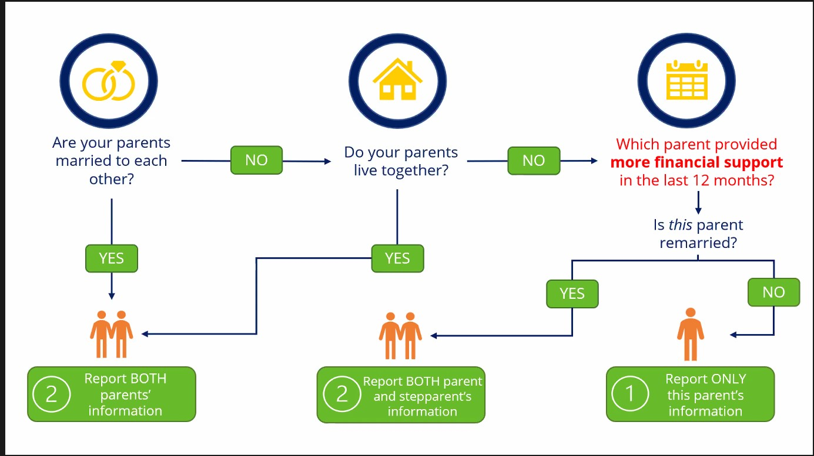
Who reports information?
hi

Slide 9
Changes to the FAFSA
hi

Slide 10
Changes to the FAFSA
hi

Slide 11
Changes to the FAFSA
hi

Slide 12
Changes to the FAFSA
hi

Slide 13
Changes to the FAFSA
hi

Slide 14
Changes to the FAFSA
hi

Slide 15
Helpful Websites and Videos
https://www.youtube.com/@FederalStudentAid
www.collegeforalltexans.com
Slides 8-15 come from Uaspire Online Training
https://www.uaspire.org/
hi

